Slide 1
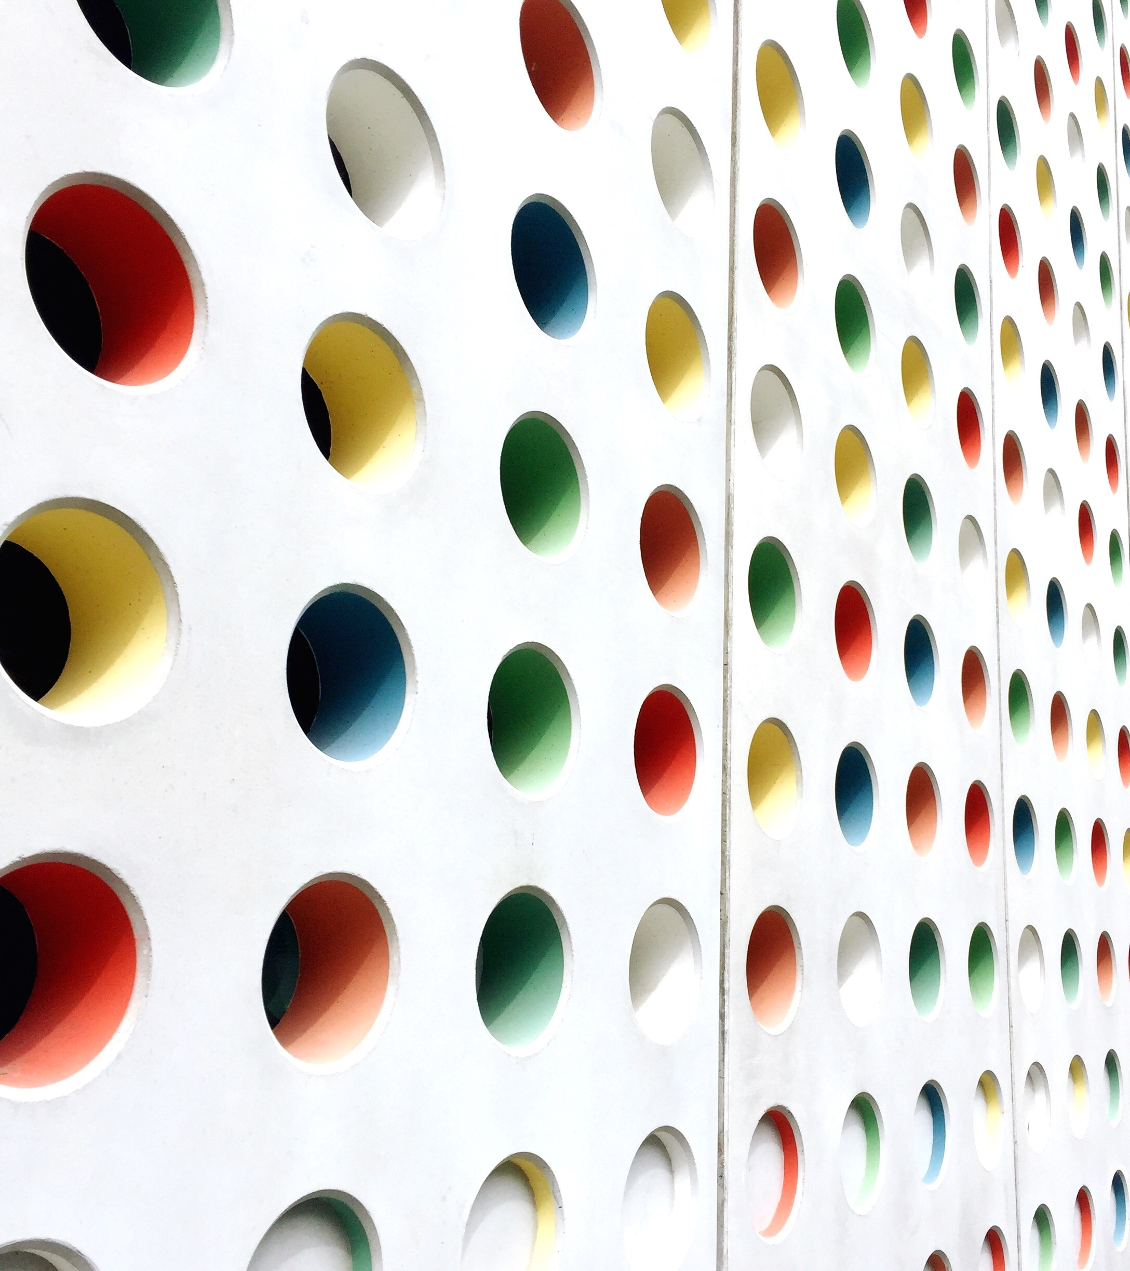
The Impact Of Social Media on Teenagers
by K. Y. Engineer

Slide 2
INTRODUCTION…
We will discuss topics like prevalence of social media usage among teenagers, average time spent online, the influence of social media on their mental health, relationships, and overall well-being.
Social Media platforms provide instant communication tools, enabling teenagers to stay connected with friends and family members regardless of geographical distance.

Slide 3




teenagers use messaging apps, video calls, and social networking sites to maintain relationships and share experiences in real-time.
Social media serves as a vast repository of information, offering access to news, educational content, tutorials, and resources on various topics. Even there are educational YouTube channels, online courses, and informative social media accounts that teenagers can follow to expand their knowledge and skills.

Slide 4

Positive Effects Of Social Media
Communication and connectivity.
Access to info and resources.
creative expressions and networking.

Slide 5
DIAGRAM SHOWING TIME SPEND BY TEENS ON DIFFERENT SOCIAL MEDIA PLATFORMS

Slide 6
Negative Effects Of Socia Media
a. Mental Health Issues: Excessive use of social media has been associated with various mental health problems, including anxiety, depression, low self-esteem, and body image issues.
b. Cyberbullying and Online Harassment: Social media platforms can be breeding grounds for cyberbullying and harassment, with teenagers being particularly vulnerable to online abuse and peer pressure.
c. Privacy Concerns and Digital Footprint: Many teenagers overlook privacy settings and share personal information online, unaware of the potential risks and consequences of their digital footprint.

Slide 7
STRATEGIES FOR RESPONSIBLE SOCIAL MEDIA USE
We as adults need 2 provide practical tips 2 teens for setting screen time limits, scheduling device-free periods, and prioritizing face-to-face interactions & encourage teenagers to explore hobbies, sports, and other activities that promote physical and mental well-being.
We need to emphasize the dual nature of social media's impact on teenagers. We as adults need to encourage teens for responsible social media usage, encourage teenagers to reflect on their social media habits and make informed choices about their online behavior, considering both the positive and negative implications. Need of the hour is to call to action for promoting digital well-being among teenagers. Advocate for ongoing conversations, education, and community initiatives aimed at fostering a healthy digital culture and empowering teenagers to harness the benefits of social media while mitigating its risks.
Digital Literacy and Critical Thinking
b. Setting Boundaries and Time Management

Slide 8
THANK YOU

